Slide 1

3.HTML
INTRODUCTION to HTML

Slide 2
HTML Lecture Contents
2. Intro To HTML
3. Headers and Paragraphs
4. Divs & Spans
5. List Types
6. Attributes

Slide 3
Lecture Contents Continued
7. Table
8. Forms
9. Forms Continued
10. Buttons Forms
11. Table Quiz
12. Table Solution

Slide 4
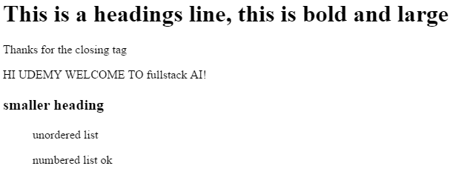
2. Intro To HTML
Identify HTML

Slide 5
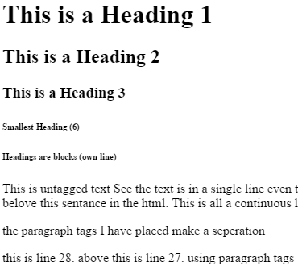
3. Headers and Paragraphs
Headings
Paragraphs

Slide 6
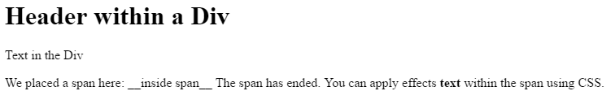
4. Divs & Spans
Divs and spans are within text

Slide 7
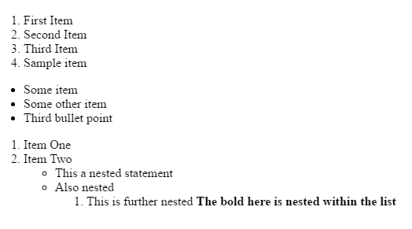
5. List Types
Making Lists in HTML

Slide 8
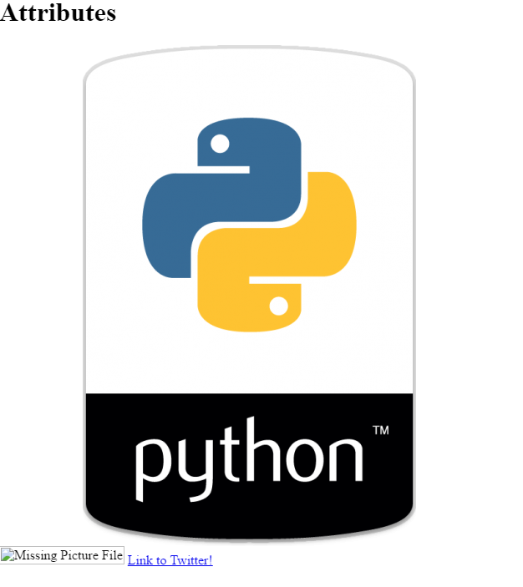
6. Attributes
Add links
Add images

Slide 9
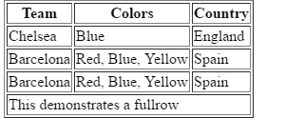
7.Tables

Slide 10
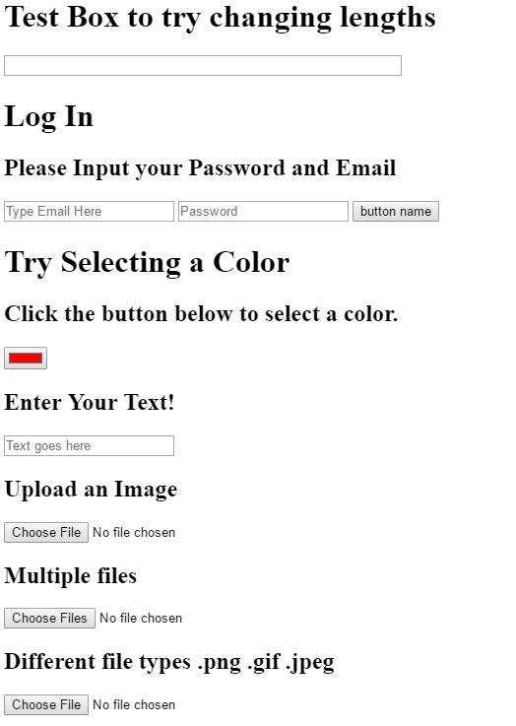
8. Forms & 9. Forms legend
Make webforms in HTML

Slide 11
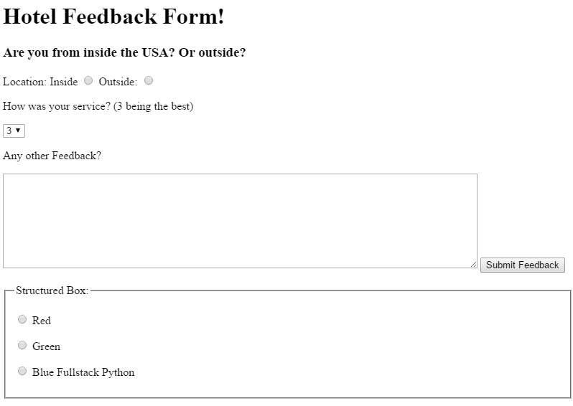
10. Buttons Forms
Making advanced forms

Slide 12
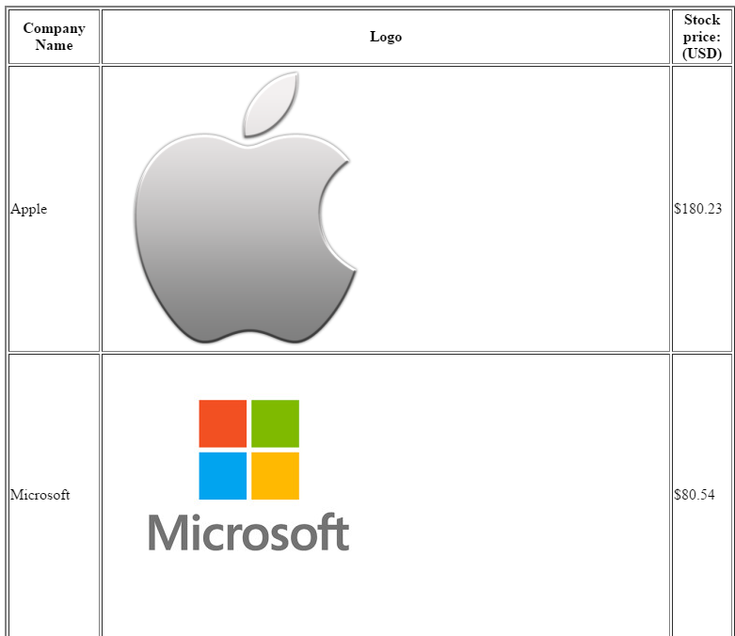
11. Table Quiz
Make a table

Slide 13
4.CSS
INTRODUCTION to CSS

Slide 14
CSS Lecture Subjects
2. CSS Colors
3. CSS Background
4. CSS Specificity
5. CSS Chrome Console

Slide 15
CSS Lecture Subjects cont.
6. Attributes
7.Web Fonts
8.Box Model

Slide 16
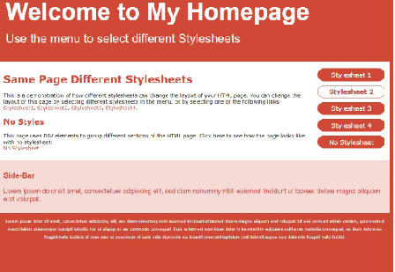
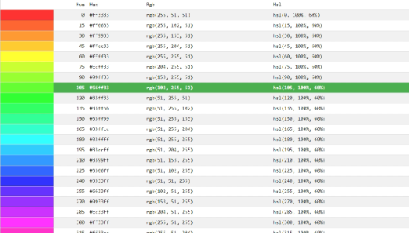
2.CSS Colors
1. Why use CSS
2. Types of Color Codes

Slide 17
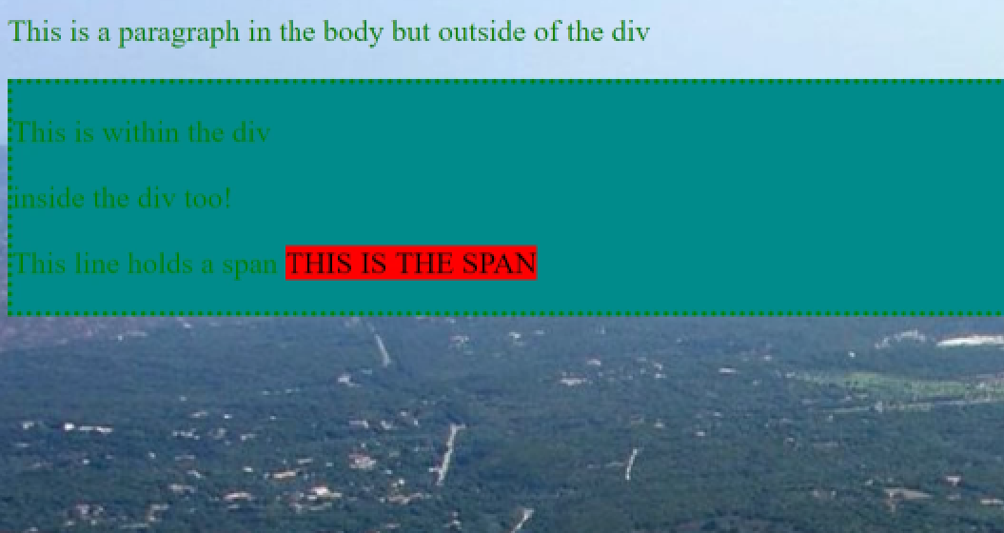
3. CSS Background
Adding backgrounds to page

Slide 18
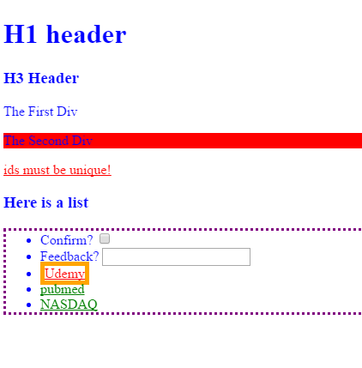
4. CSS id Classes
Identify HTML
Apply style via:
Class name
Id name
And more

Slide 19
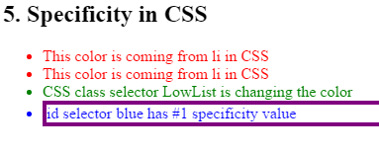
5. CSS Specificity
Identify HTML
Apply style via:
Class name
Id name
And more

Slide 20
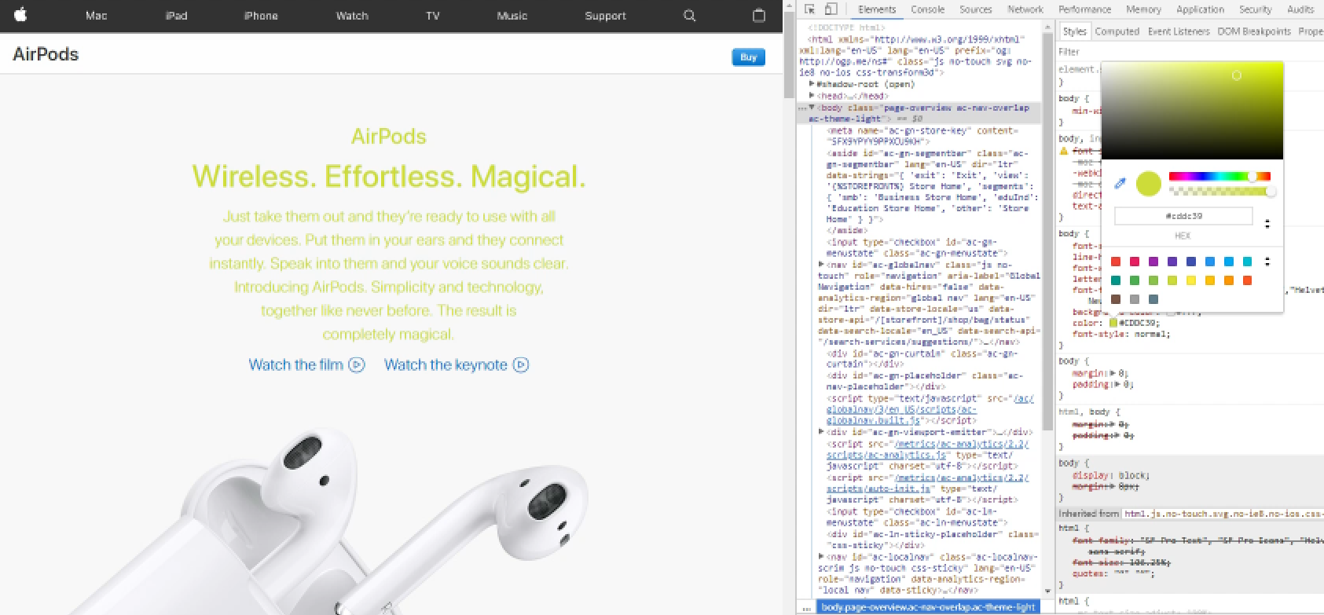
6. CSS Chrome Console
Look at the Chrome console
Apply style via console
Learn about console

Slide 21
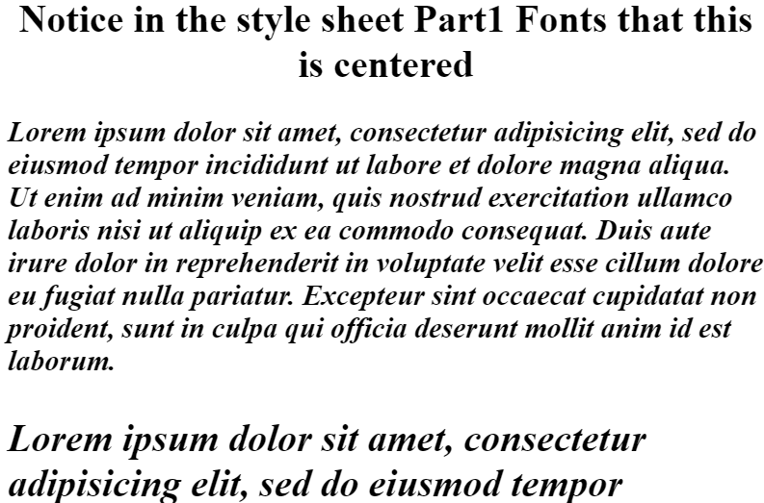
7. Web Fonts
Learn how to download link to fonts

Slide 22
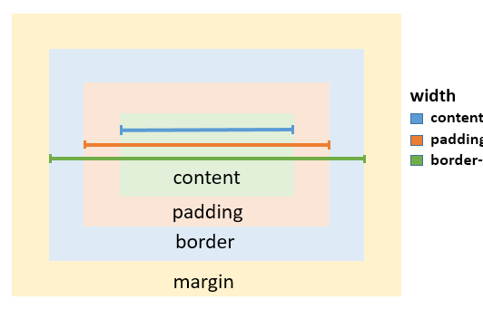
8. Box Model
Learn how organize webpage using the box model

Slide 23
5.Bootstrap
INTRODUCTION to Bootstrap

Slide 24
Bootstrap Lecture Contents
2. Intro to Bootstrap
3. Bootstrap Forms
4. Bootstrap Navbar
5. Bootstrap Grids
6. Test Project

Slide 25
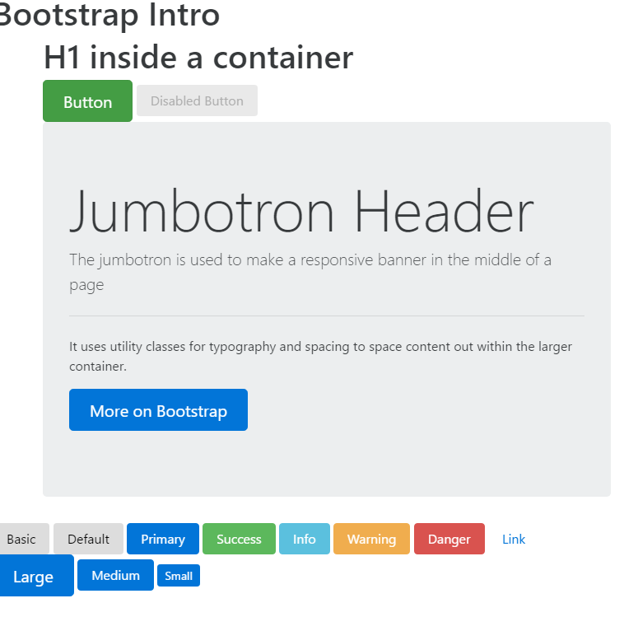
2. Intro to Bootstrap

Slide 26
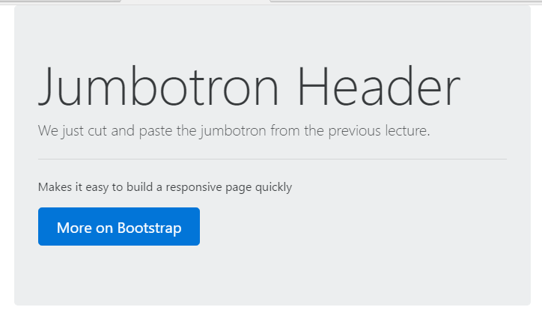
3. Bootstrap Forms
Making Jumbotrons
Making forms

Slide 27
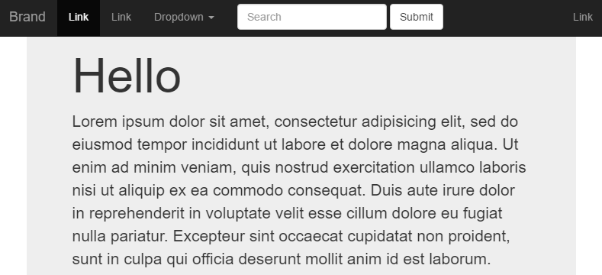
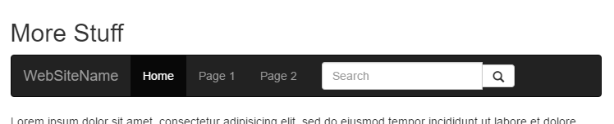
4. Bootstrap Navbar
Making Navbars
Top of page
Bottom of Page

Slide 28
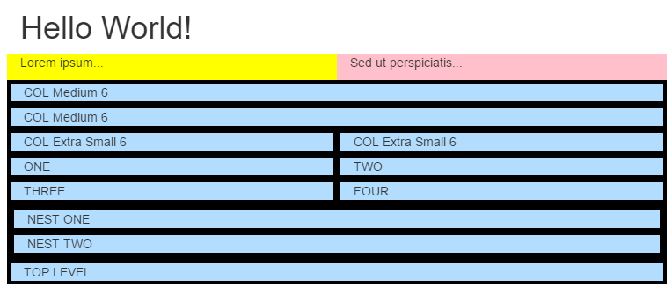
5. Bootstrap Grids
Grids

Slide 29
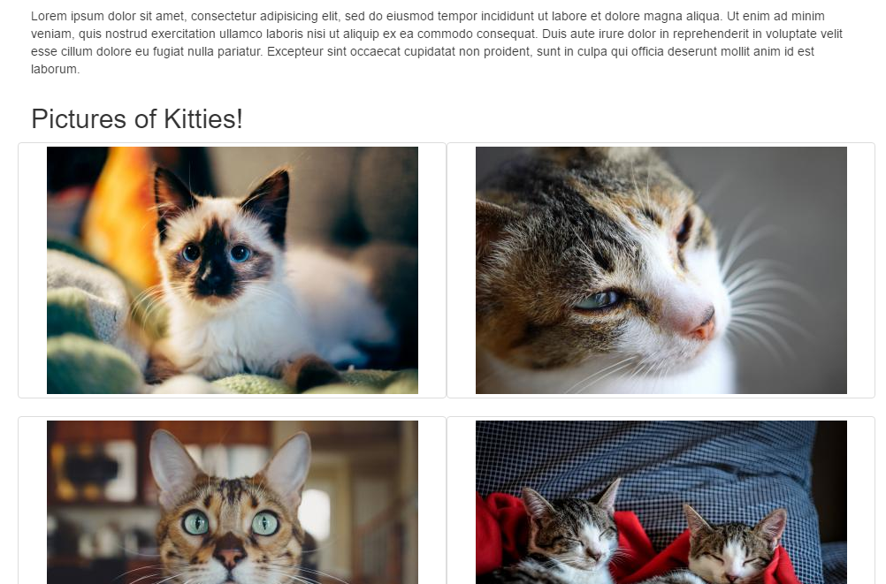
6. Test Project
Make a webpage

Slide 30
6. Javascript
JS Operators, variables, console

Slide 31
Javascript Lecture Contents
2. JS variables & console
3. JS to HTML
4. JS operators
5. JS control flow

Slide 32
Javascript Lecture Contents [continued]
6. JS while loops
7. JS for loops
8. JS exercises
9. JS exercises solutions
10. JS functions
11. JS function exercises

Slide 33
Javascript Lecture Contents [continued]
12. JS functions solutions
13. JS functions arrays
14. JS objects
15. JS objects exercises
16. JS object answers

Slide 34
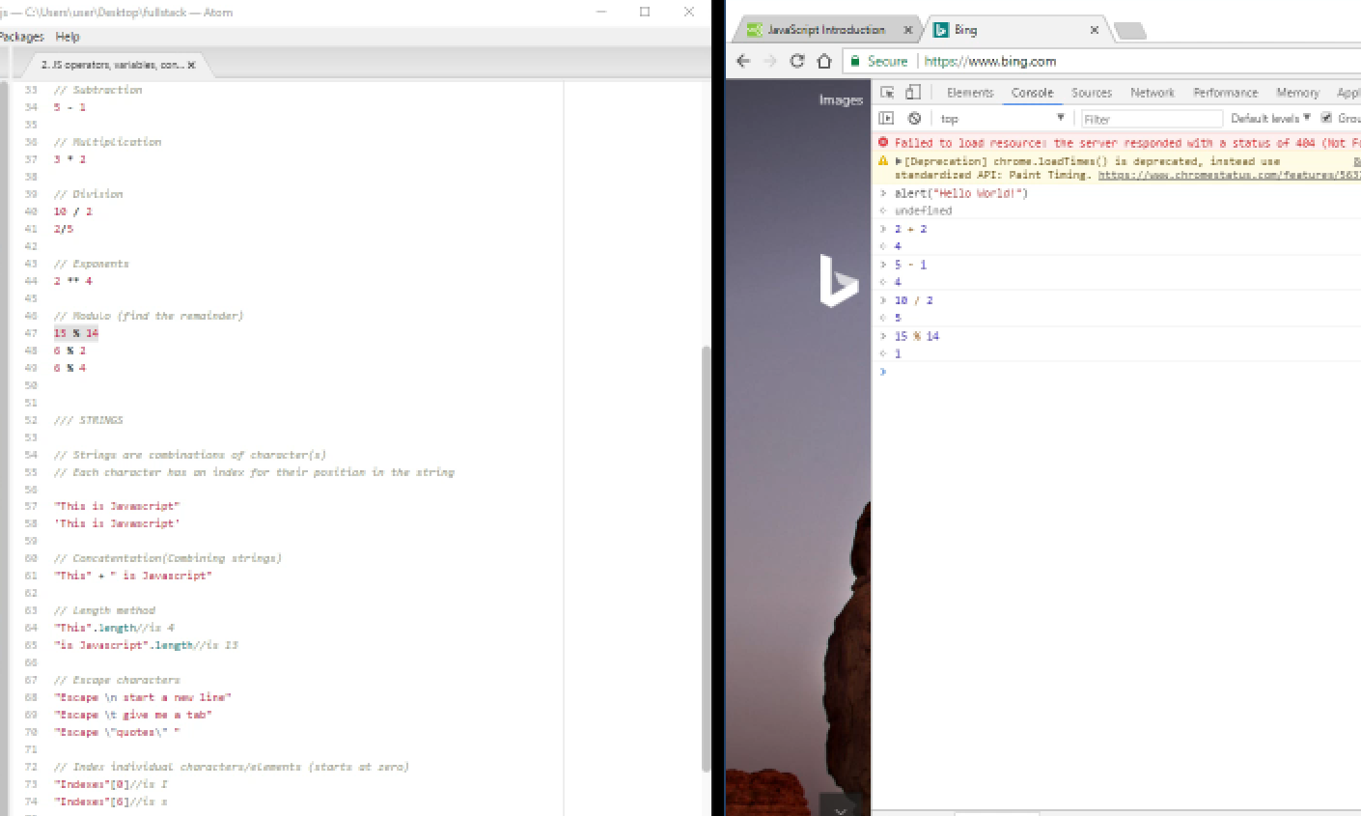
2. JS variables & console
Use chrome console to run JS

Slide 35
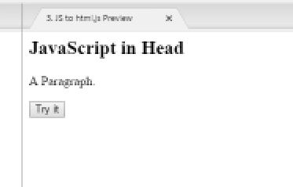
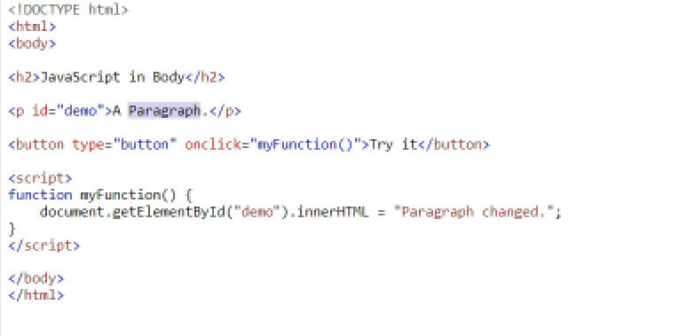
3. JS to HTML
Using JS with HTML

Slide 36
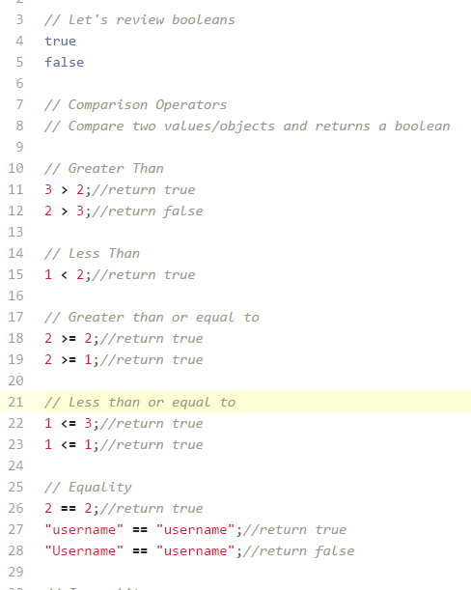
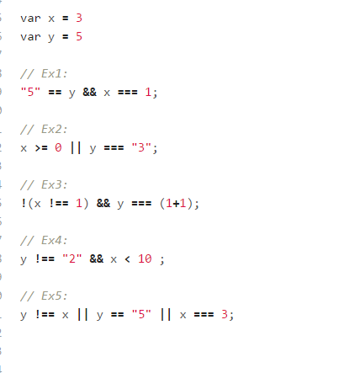
4. JS operators
Doing operations with JS

Slide 37
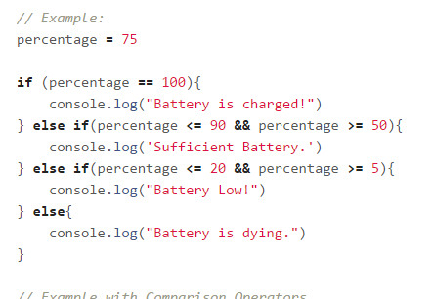
5. JS control flow
If, else if, and else statements

Slide 38
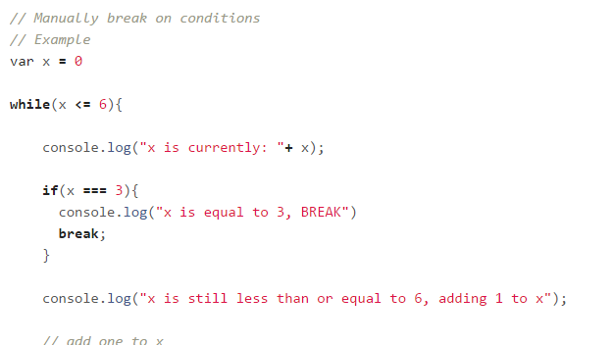
6. JS while loops
Learning to use while loops

Slide 39
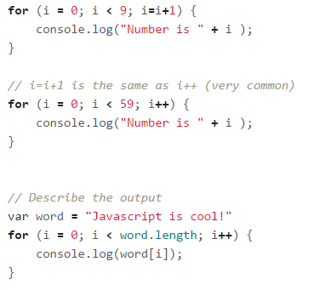
7. JS for loops
For loops

Slide 40
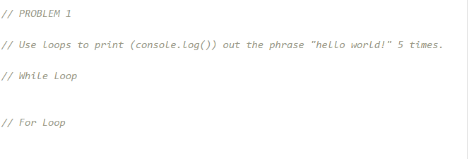
8. JS exercises
Do 2 quick exercises

Slide 41
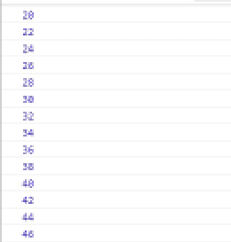
9. JS exercises solutions
See results and work through solutions

Slide 42
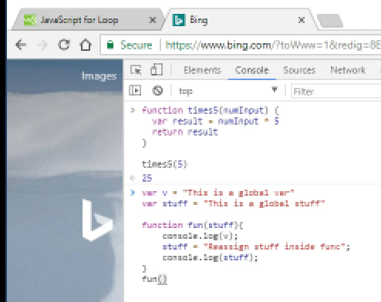
10. JS functions
Js functions

Slide 43
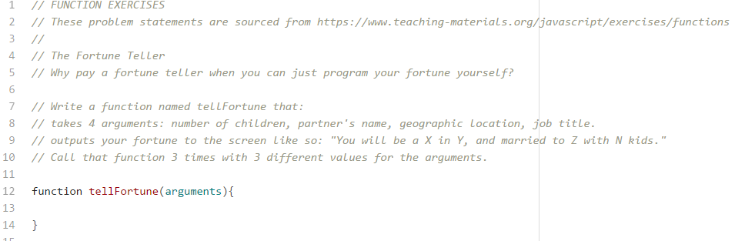
11. JS function exercises
Do two exercsies in JS

Slide 44
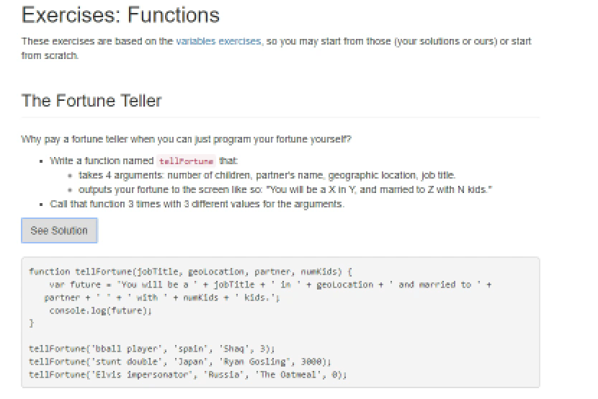
12. JS functions solutions
JS functions exercises

Slide 45
13. JS functions arrays
Make JS arrays

Slide 46
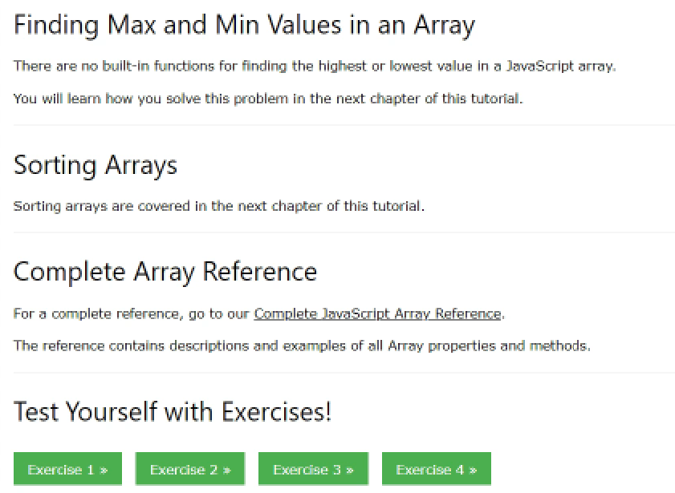
14. JS objects
JS objects and array methods

Slide 47
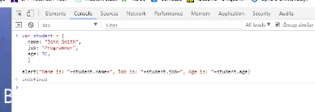
15. JS objects exercises
Object exercises

Slide 48
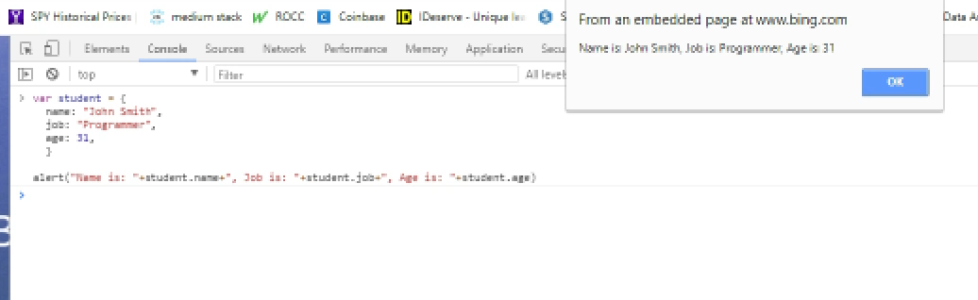
16. JS object answers
Answers to previous exercise

Slide 49
7. DOM
Intro to the Document Object Module

Slide 50
DOM Lecture Contents
2. DOM console
3. DOM console Part 2
4. Event Listeners
5. Game project

Slide 51
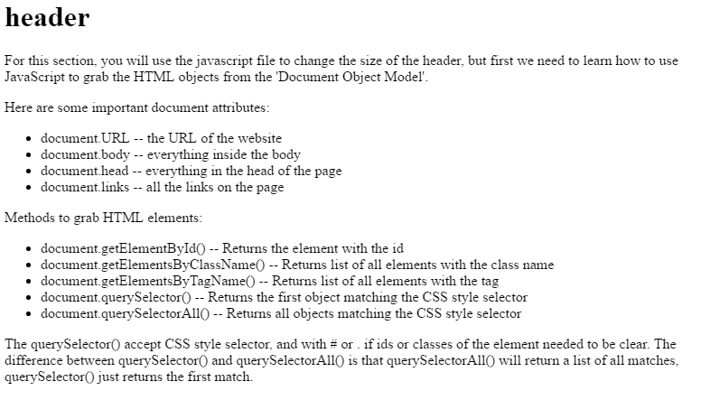
2. DOM console
Using JS to grab HTML via dom

Slide 52
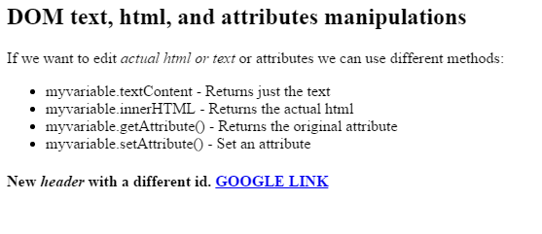
3. DOM console Part 2
Using DOM to edit text, html and attributes

Slide 53
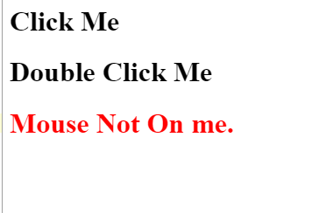
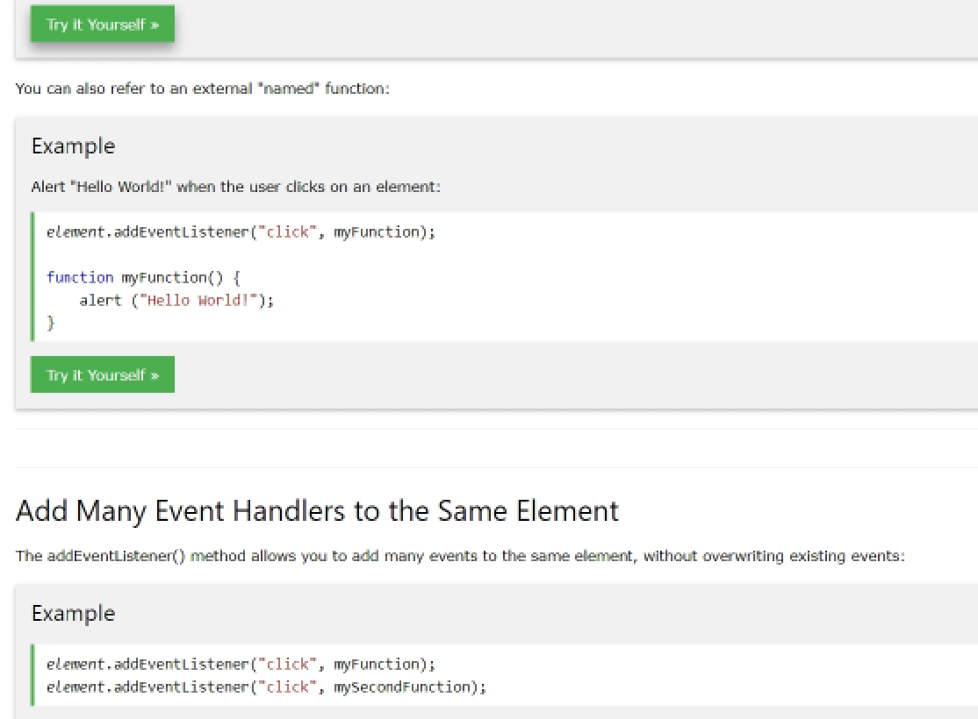
4. Event Listeners
Using mouseovers and clicks to get info from users

Slide 54
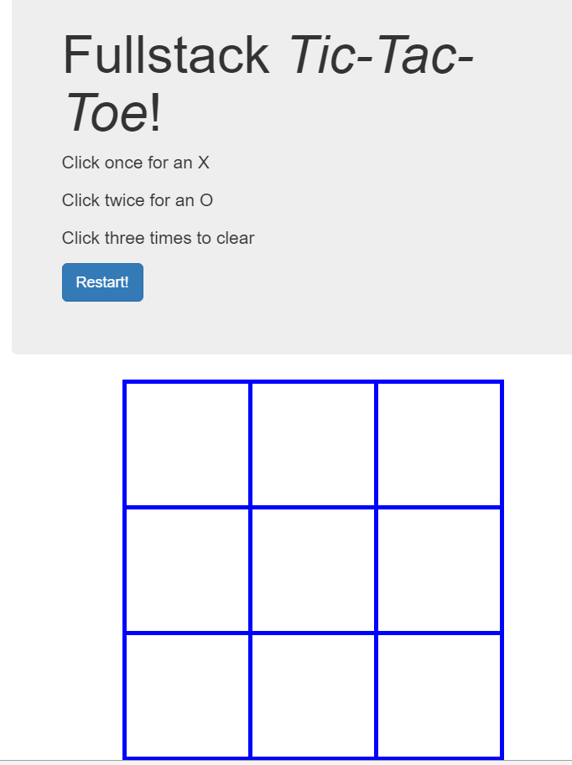
5. Game project
Tic Tac Toe

Slide 55
8. Introduction to jQuery

Slide 56
jQuery Lecture Contents
2. intro to jQuery
3. jQuery Events
4. jQuery Projects

Slide 57
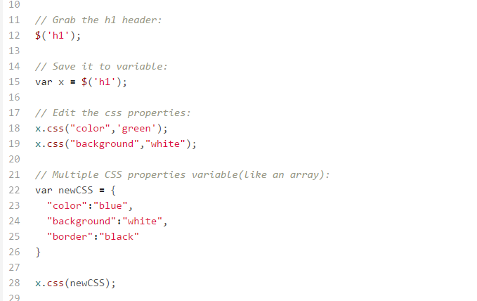
2. intro to jQuery
How to use jQuery

Slide 58
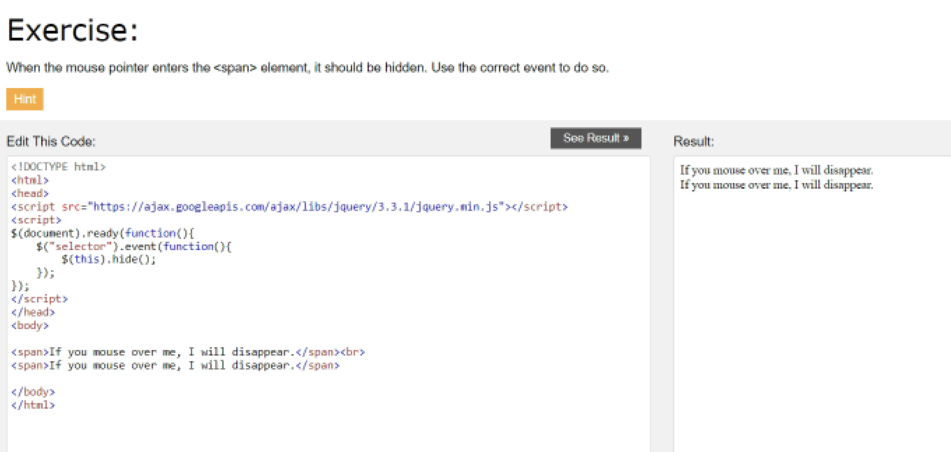
3. jQuery Events
Using jQuery to interact with users

Slide 59
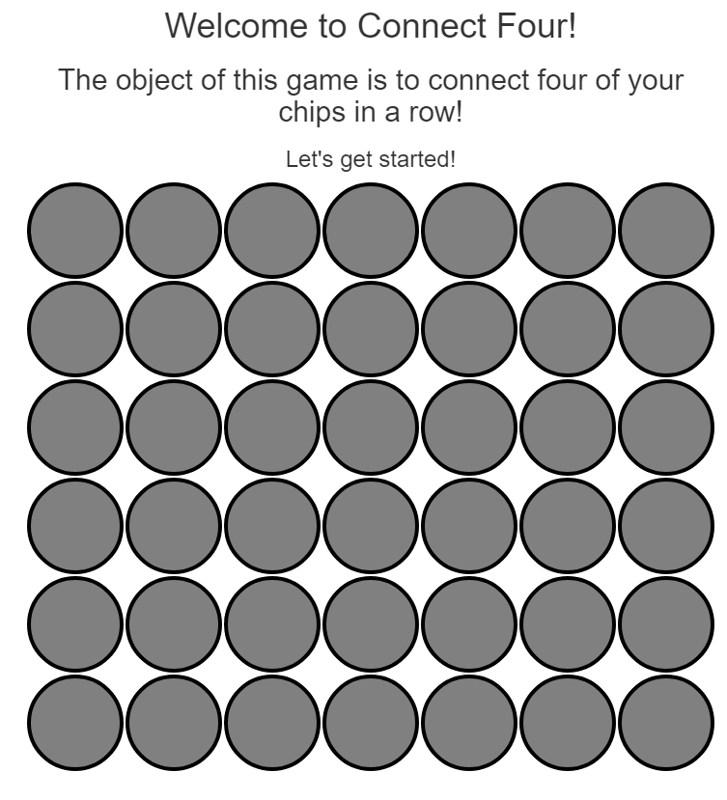
4. jQuery Projects
Connect 4 project

Slide 60
9. Python
Introduction to Python

Slide 61
Python Lecture Contents
2. Python Numbers
3. Python Strings
4. Python Lists
5. Python Dictionaries
6. Python Tuples & Booleans

Slide 62
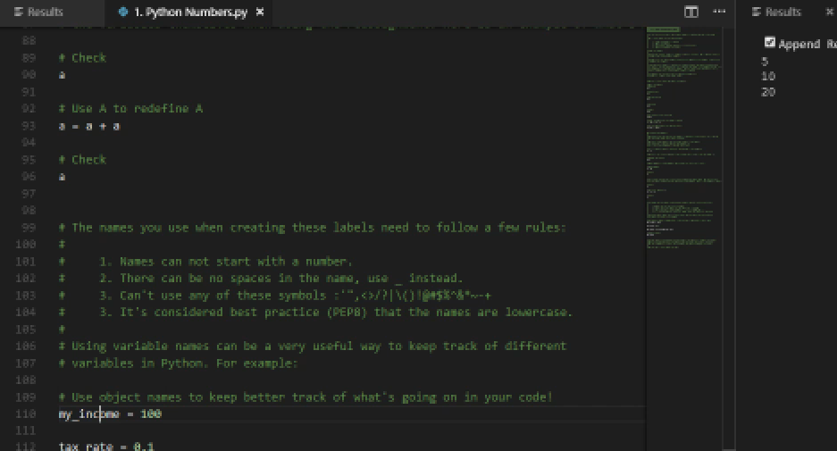
2. Python Numbers
Types of Numbers in Python
Basic Arithmetic
Differences between Python 2 vs 3
Object Assignment in Python

Slide 63
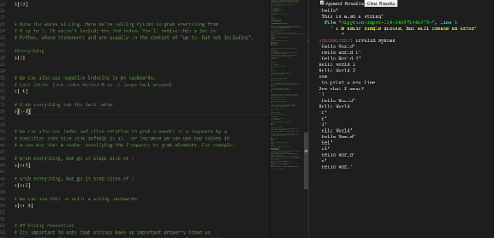
3. Python Strings
Creating Strings
Printing Strings
String Indexing and Slicing
String Methods
Print Formatting

Slide 64
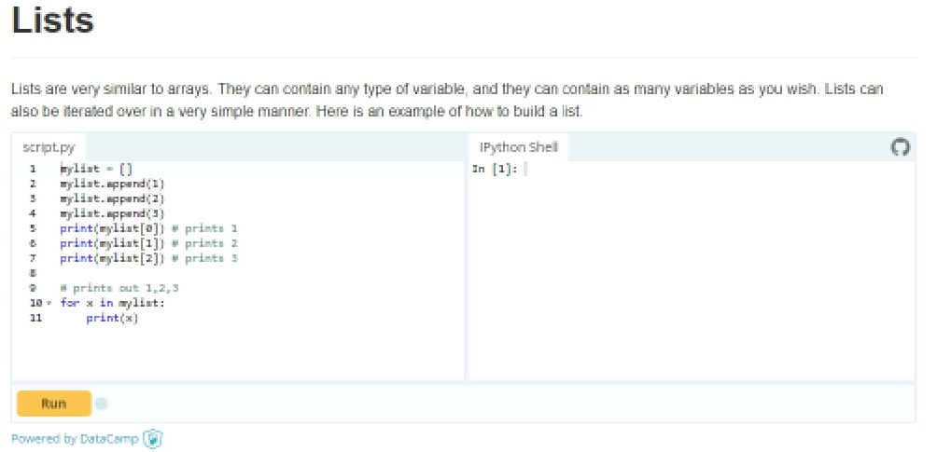
4. Python Lists
Creating Lists
Indexing and Slicing Lists
Basic Lists
Nesting Lists
Introduction to list comprehensions

Slide 65

5. Python Dictionaries
Constructing a Dictionary
Accessing objects from Dictionaries
Nesting Dictionaries
Basic Dictionary Methods

Slide 66

6. Python Tuples & Booleans
Constructing Tuples
Basic Tuple Methods
Immutability
When to use Tuples

Slide 67
10. Python Flow Control

Slide 68
Python Flow Control Lecture Contents
2. Test Conditions w/if, Elif & Else
3. For Loops
4. Extending for loops
5. Continue, break, else
6. Augmented Assignment

Slide 69
Python Flow Control Lecture Contents
7. While Loops
8. While Loop Challenge
9. Exercise Assignemt

Slide 70

2. Test conditions using if & else
Perform actions based on results

Slide 71

3. For Loops
For loops examples

Slide 72

4. Extending for loops
Cleaning numbers using for loops

Slide 73

5. Continue, break, else
Learn how to work with loops
Use else, if and break in loops

Slide 74

6. Augmented Assignment
"+=" | "-=" | "*=" | "/=" | "%=" | "**=“
Learn how to use the above expressions

Slide 75


7. While Loops
While loops with for loops

Slide 76
7. While Loops
Create a the program that will allow you as many guesses to pick # a number between 1 and 1000.

Slide 77

8. While Loop Challenge
A programming a challenge

Slide 78

9. Exercise Assignemt
Create a program that takes an IP address entered at the keyboard
prints out the number of segments it contains, and the length of each segment.

Slide 79
11. Python Lists, Ranges, Tuples

Slide 80
Python Lists, Ranges, Tuples Lecture Contents
2. Intro to Lists
3. Lists
4. List Exercise
5. Iterators
6. Ranges

Slide 81
Python Lists, Ranges, Tuples Lecture Contents
7. Slices
8. Tuples
9. Tuples Continued
10. Advanced Exercise

Slide 82


2. Intro to Lists 3. Lists 4. List Exercise
Sort, append, count, extend
Lists

Slide 83
5. Iterators
Iterating through lists

Slide 84
6. Ranges
Learn what a range is
Iterate a list
Nested comprehensions
Check whether a number is in a range

Slide 85

7. Slices
Index and slice lists
Manipulate sequences
Printing lists by using loops

Slide 86

8. Tuples 9. Tuples continued
How to work with tuples
Discuss hashing

Slide 87


10. Advanced Exercises
Fibonacci sequence exercise
Music Album Exercise

Slide 88
12. Python Dictionaries

Slide 89
1.Dictionaries and Sets 2.Dictionaries continued
Constructing a Dictionaries
Accessing Objects
Nesting Dictionaries
Basic Dictionary Methods

Slide 90
13. Python Input and Output

Slide 91

2. Python Input and output
Read from text file
Save as a text file

Slide 92
14. Methods and Functions in Python

Slide 93
Methods and Functions in Python Contents
2.Methods
3. Functions
4. Decorators
5. Scope
6. Advanced Methods

Slide 94
2. Methods
Functions built into objects
Objects can do methods
Instance Methods
Class Methods

Slide 95
3. Functions
Functions can do stuff
Pass arguments to Functions
Rules of writing good Functions

Slide 96
4. Decorators
Software design patterns
Alter the functionality of methods, function
Class decorators
Decorator Chain

Slide 97
5. Scope
Local vs global
LEGB rule
Local
Enclosing
Global
Built In

Slide 98
6. Advanced Methods
Instance Methods
Static Methods
User defined Methods

Slide 99
15. Object Oriented Programming

Slide 100
Object Oriented Programming Contents
2. Object Oriented Programming
3. Inheritance, Composition

Slide 101
2. Object Oriented Programming
Creating an instance from a class
Attribute shadowing

Slide 102

3. Inheritance, Composition
Inheritance
Composition

Slide 103
16. Statistics Projects

Slide 104
Statistics Projects Contents
1. Descriptive Statistics
2.Classical Inference Proportions
3. Classical InferenceMeans

Slide 105
1. Descriptive Statistics Contents
Scikit AKA sklearn
Load dataset
Quantiles
Describe() method
Range
Aggregate()

Slide 106

2.Classical Inference Proportions Contents
Confidence Intervals
Confidence Interval for Population Proportion
Testing the Proportion
chi^2

Slide 107


3. Classical InferenceMeans Contents
2. Two- Sample Test for Common Mean
One way ANOVA

Slide 108
17. Bayesian Projects

Slide 109
Bayesian Projects Contents
4. Bayesian Analysis
5. Bayesian Inference Proportions
6. Bayesian Inference Means
7. Correlations

Slide 110

4. Bayesian Analysis
Bayes Theorem

Slide 111


5. Bayesian Inference Proportions
Posterior Analysis
Hypothesis Testing
Conjugate Priors
Compare two proportions

Slide 112



6. Bayesian Inference Means
Conjugate Priors
DNIG
Credible Interval for the Mean

Slide 113



7. Correlations
Pearson correlation
Using Pandas and SciPy
Sklearn with Dataset
Matplots heatmap
Correlation

Slide 114
18. Machine Learning Introduction

Slide 115
Machine Learning Introduction Contents
8. Machine Learning Principles
9. Training ML models
10. Evaluating Model Results

Slide 116



8. Machine Learning Principles
Supervised vs Unsupervised Learning
Matplots
Supervised Learning
Loss Function
Generalize
Testing Algorithm predictions

Slide 117
9. Training ML models
Overfitting
Underfitting
Cross Validation
k Folds
Using Dataframe Methods (.mean())

Slide 118


10. Evaluating Model Results
Precision
Recall
F1 Score
Bayes Factor

Slide 119
19. Deep Learning Projects

Slide 120
Deep Learning Content
11. KNN
12. Decision Tree
13. Random Forests
14. OLS
15. Evaluating Linear Model
16. Ridge Regression

Slide 121
Deep Learning Content
17. LASSO Regression
18. Interpolation
19. Perceptron Basic
20. Training Neural Network
21. Regression Neural Network
22. Clustering
23. Evaluating Cluster Model
24. kMeans

Slide 122
Deep Learning Content
25. Hierarchal
26. Spectral
27. PCA
28. SVD
29. Low Dimensional

Slide 123

11. KNN
k – Nearest neighbors algo
Creating Classifiers
Selecting k
Using k to predict

Slide 124
12. Decision Tree
Scikit – learn
Fitting a Decision Tree
Control overfitting by restricting tree depth

Slide 125

13. Random Forests
Ensemble methods
Growing a Random Forest
Optimizing Hyperparameters

Slide 126
14. OLS
Linear Models with OLS
Regression
Fitting
Cross validation

Slide 127
15. Evaluating Linear Model
Statsmodel for fitting linear models
Use AIC
Comparing models using mean squared Error

Slide 128
16. Ridge Regression
Regularization parameters
Fitting using scikit Learn

Slide 129
17. LASSO Regression
Least absolute shrinkage and selection operator
Fitting using LASSO
Using smaller alpha for better fits
Compare to OLS

Slide 130



18. Interpolation
spline interpolation
Univariate interpolation 1D
Multivariate interpolation 2D

Slide 131
19. Perceptron Basic
Training a perceptron type linear classifier
Online learning

Slide 132

20. Training Neural Network
Handwriting analysis
Multilayer perceptron
Fitting an MLP

Slide 133
21. Regression Neural Network
Basic RNN with 100 neurons
Alpha is 10

Slide 134
22. Clustering
Distance types
Euclidiean
Angular
Hamming
Jaccard
Manhattan

Slide 135



23. Evaluating Cluster Model
Clusters in datasets
Finding elbow
Silhouette Analysis

Slide 136


24. kMeans
K means clustering
image compression

Slide 137


25. Hierarchal
Hierarchal Clustering
Similarity Scores
Agglomerative Clustering
Clustering Words
Silhouette Plots

Slide 138

26. Spectral
Spectral clustering
Clustering words

Slide 139

27. PCA
Principal Component Analysis
Dimensionality reduction when uncorrelated

Slide 140

28. SVD
Singular value decomposition
Dense vs sparse data
Compact SVD
Find matrices

Slide 141

29. Low Dimensional
Multi-dimensional scaling
Reduce dimensionality then restore
Sometimes no clustering restored

Slide 142
20. Machine Learning AI

Slide 143
Machine Learning AI Contents
1. Machine Learning
2. Training Algorithm
3. SciKit
4. Data Preprocessing
5. Dimesionality Reduction
6. Hyperparemeter Optimization
7. Ensemble Learning
8. Sentiment Analysis

Slide 144
Machine Learning AI Contents
9. Regression Analysis
10.Cluster Analysis
11. Artificial Neural Networks
12. TensorFlow
13. TensorFlow Workshop
14. Convolutional Neural Networks
15. Recurrent Neural Networks

Slide 145


1. Machine Learning
Building intelligent machines
Make future predictions
The road to AI

Slide 146



2. Training Algorithm
Artificial neurons, neural gates
Perceptron
Gradient descent and feature scaling

Slide 147


3. SciKit
Choosing algos
Perceptron models
Vector machines
Kernel SVN with hyperplanes
kNN
Decision tree

Slide 148
4. Data Preprocessing
Dealing with missing data
Scikit learn API
Categorical data
One hot encoding on nominal
Geometric L1/L2 regularization
Random forests

Slide 149



5. Dimesionality Reduction
PCA
Variance total and explained
LDA
Kernel PCA

Slide 150

6. Hyperparameter Optimization
Combining estimators and transformers
Learning curves bias vs variance
Plotting underfitting overfitting
Algo selection

Slide 151



7. Ensemble Learning
Unanimity vs majority vs plurality
Majority voting to improve predictions
Bagging
Leveraging weak learners via adaptive boosting

Slide 152

8. Sentiment Analysis
Preprocessing and cleaning data
Word relevancy via frequency inverse document frequency
Documents to tokens
Training regression model for doc classification
Latent Dirichlet allocation

Slide 153



9. Regression Analysis
Linear regression simple
Multiple linear regression
Visulize all dataset

Slide 154



10. Cluster Analysis
K means using scikit
Hierarchical tree clusters
DBSCAN & agglomerative

Slide 155



11. Artificial Neural Networks
Multilayer neural network
Handwriting analysis
Training ANN, logistic cost function
Neural backpropagation

Slide 156

12. TensorFlow
Learning models with TensorFlow
Build MNN w/ Tensor APIs
Choosing activation functions MNNs

Slide 157


13. TensorFlow Workshop
Ranks
Tensors to multidimensional arrays
Computation graph
Tensor board

Slide 158



14. Convolutional Neural Networks
CNN padding, convolutional output
Training w/dropout
Tensorboard for CNN
Weights
Biases
Reduce overfitting

Slide 159




15. Recurrent Neural Networks
Single to multi RNN
Training and long range interactions
Build language translator
Character level modeling
Learning over 200 epochs

